Slide 1

A Unified, Scalable Framework for Neural Population Decoding
Azabou et al.
Neurips 2023
Presented by: Alireza Ghalambor
February 19, 2025

Slide 2
Foundational
models

Slide 3
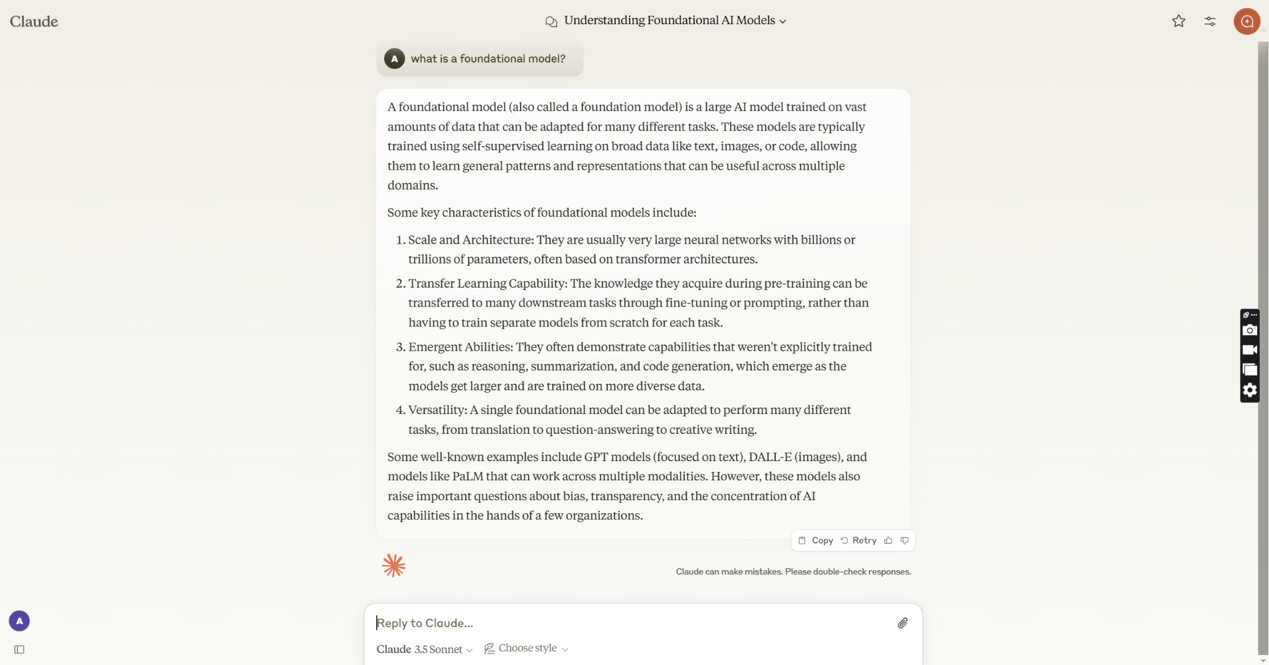
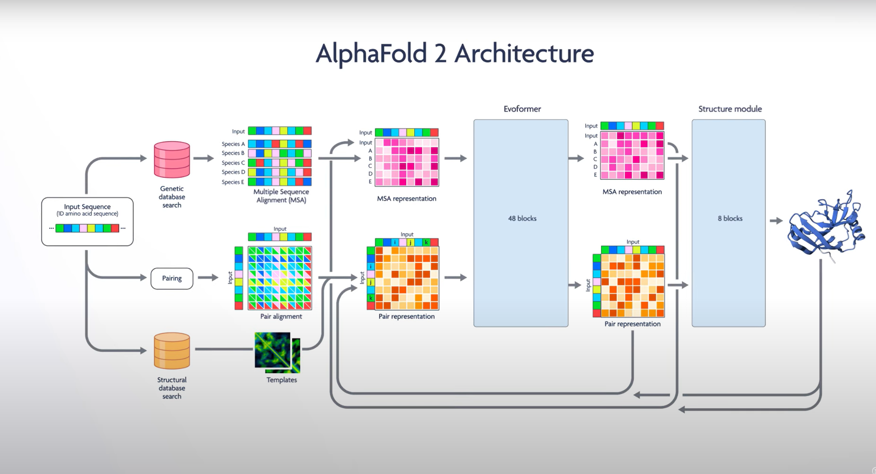
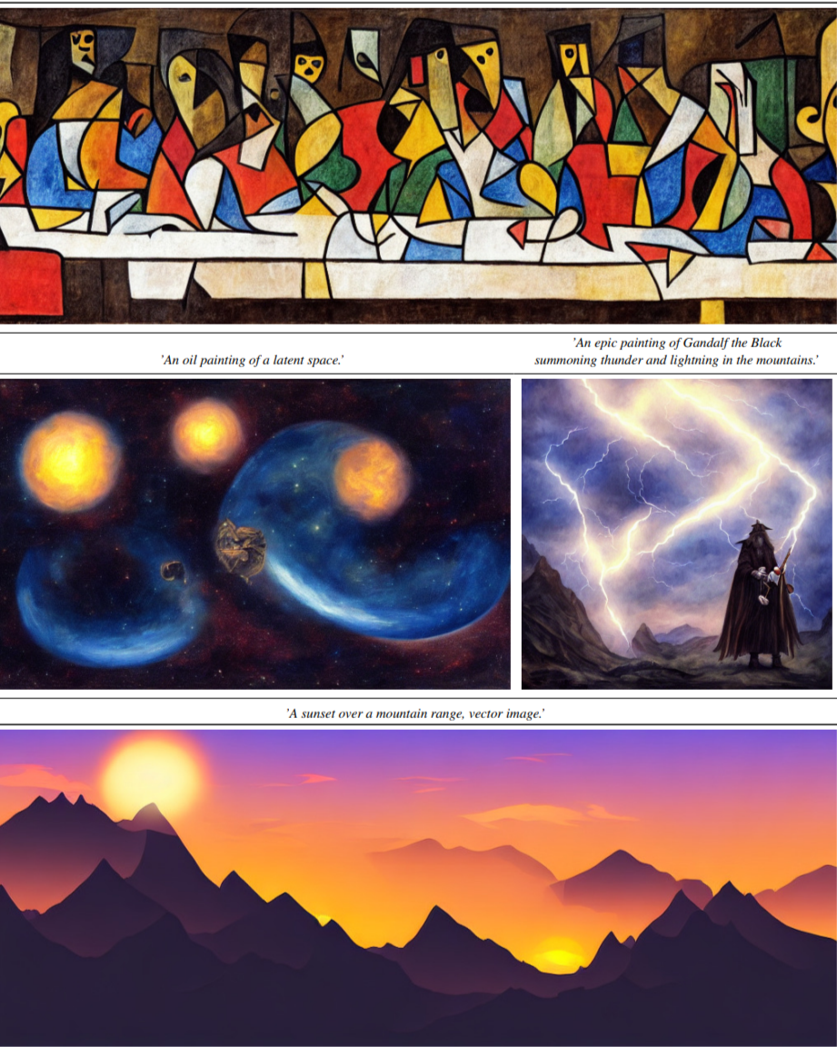

Slide 4
Defining features of foundation models
Trained with unsupervised/self-supervised pre-training
Fined-tuned on downstream tasks
Trained on vast amounts of data
Uses extensive computing power
Contains billions of parameters
May develop emergent capabilities

Slide 5
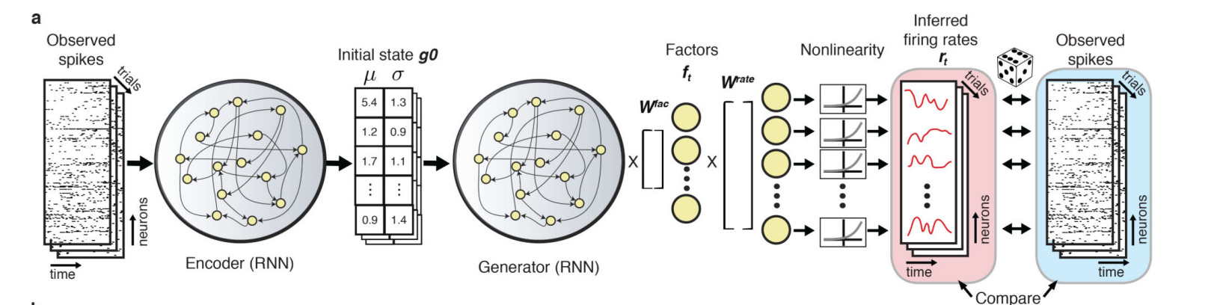
Latent Factor Analysis via Dynamical Systems (LFADS)
Not good at transferring the knowledge between sessions !
Pandarinath et al. (2018)

Slide 6
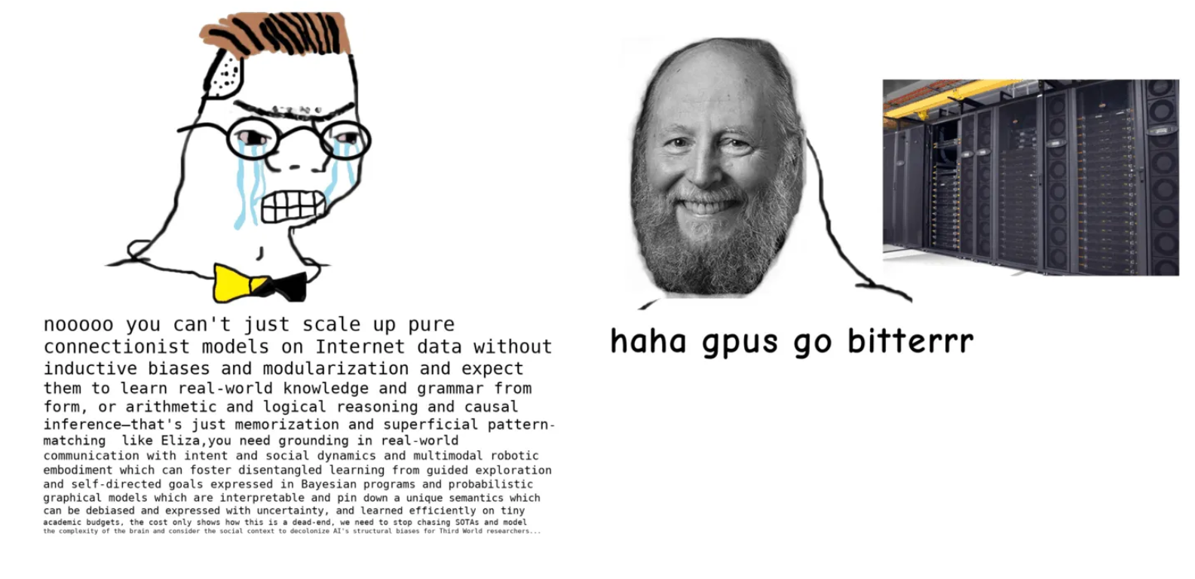
The bitter lesson !
The problem might be the lack of scale in data and compute
Image from Gwern

Slide 7
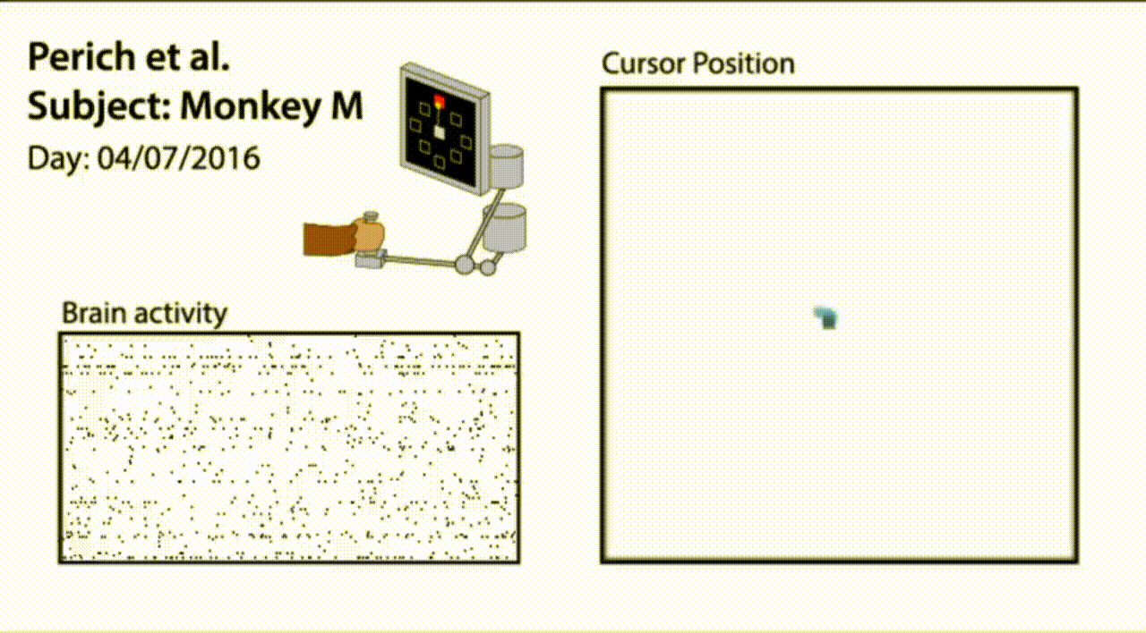
Incorporating the bitter lesson !
Azabou et al. (2023)

Slide 8

POYO = Pretrain On manY neurOns

Slide 9
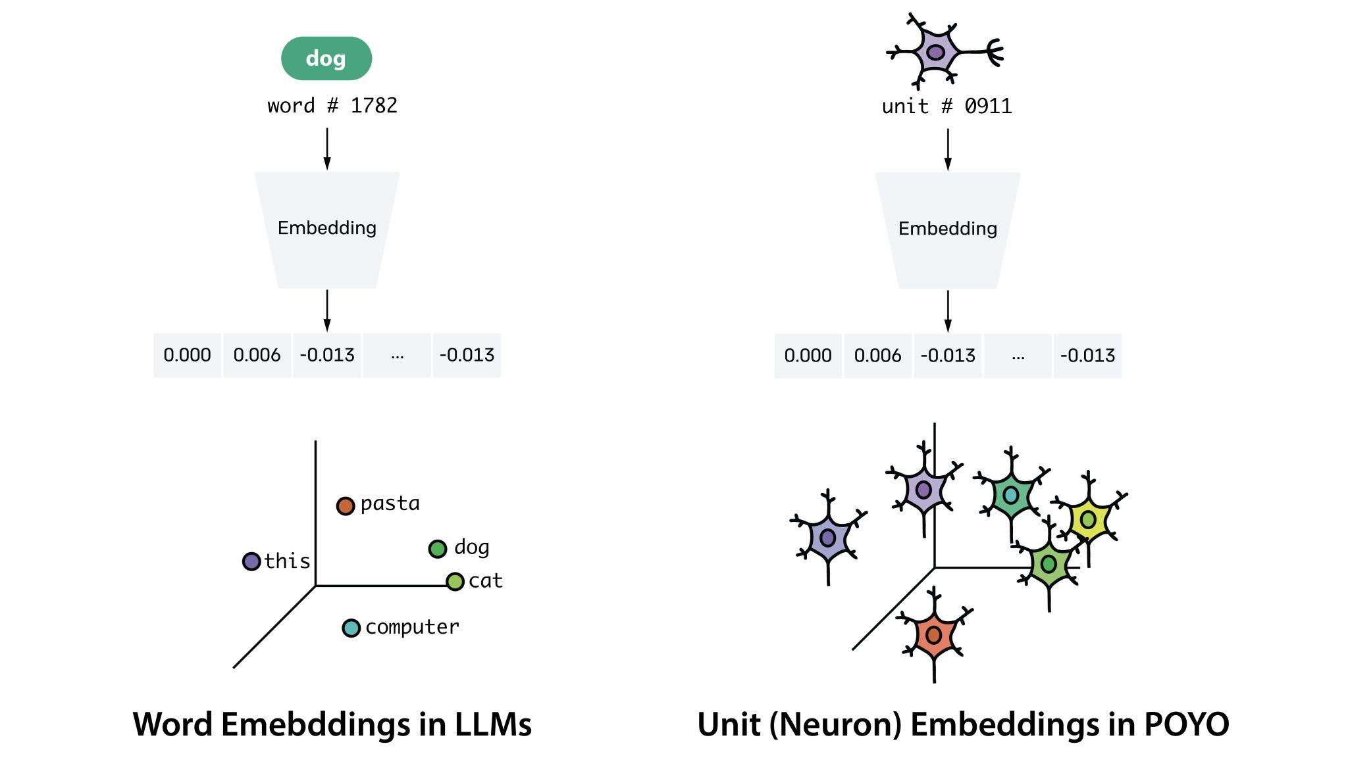
Unit embedding

Slide 10
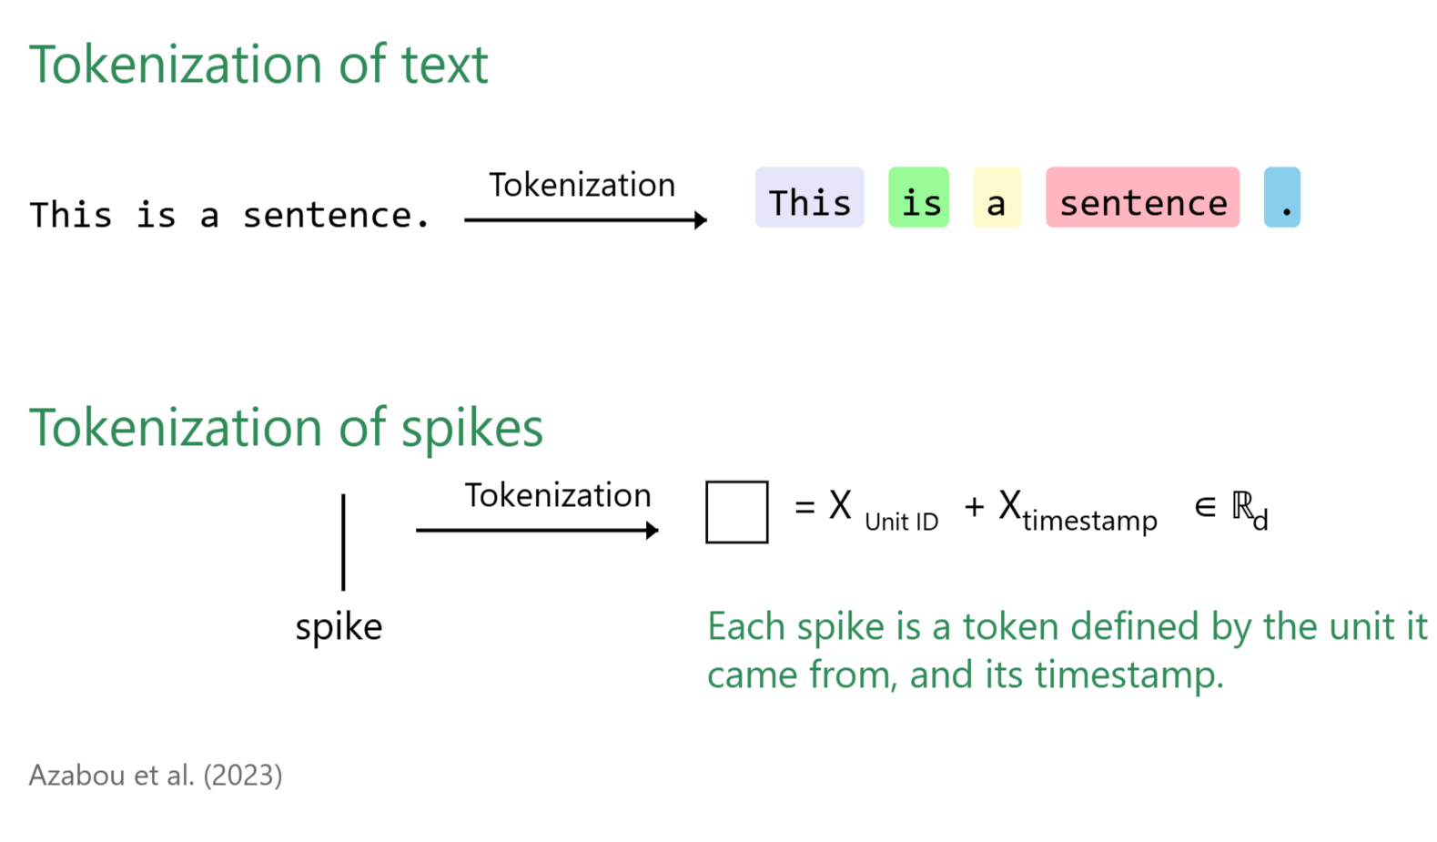
Spike Tokenization

Slide 11
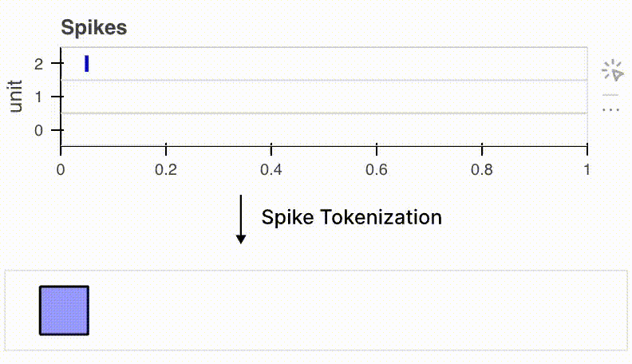
Spike Tokenization
Azabou et al. (2023)

Slide 12
Context Window: Two Approaches
Context Window: Two Approaches
Language Models (like GPT):
Fixed number of tokens (e.g., 4000 words)
POYO (Neural Data):
Fixed time window (1 second)
Number of spikes can vary
Why Time-Based for Neural Data?
Neurons fire at different rates
Some areas have 10 neurons, others 100+
Time keeps analysis consistent across recordings
Implementation
Sliding windows: move by 500ms steps
Overlap windows to maintain continuity
Average predictions where windows overlap

Slide 13
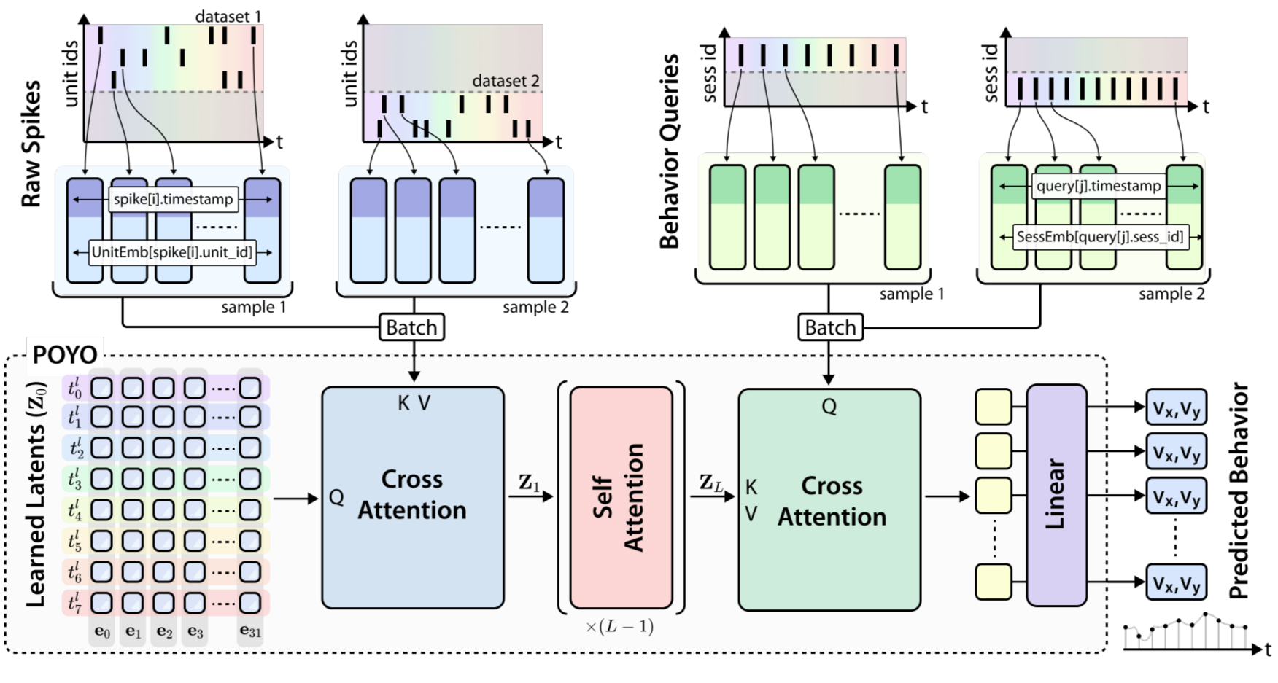
POYO architecture
PerceiverIO based - Initial queries are fixed, and learned -- Latent Queries
Cross-Attention: Compresses spikes into small number of latent tokens
Self-Attention layers: Process tokens in latent space
Cross-Attention: Query latent-tokens for behavior at required timestamps
Linear projection into R2: vx, vy

Slide 14
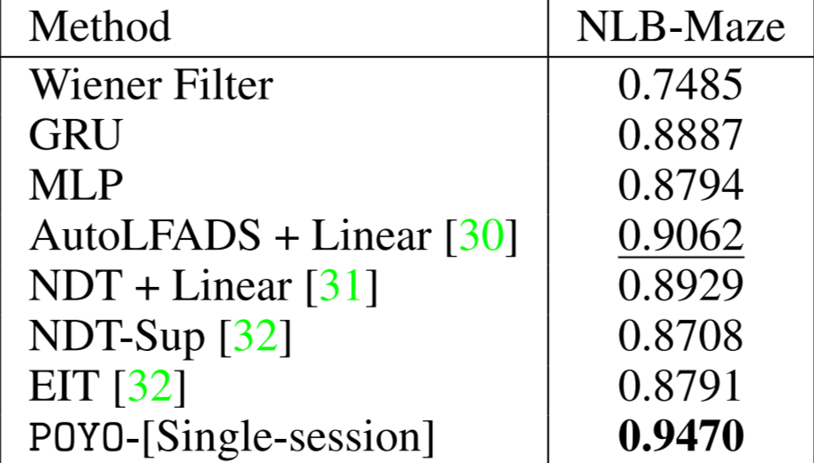
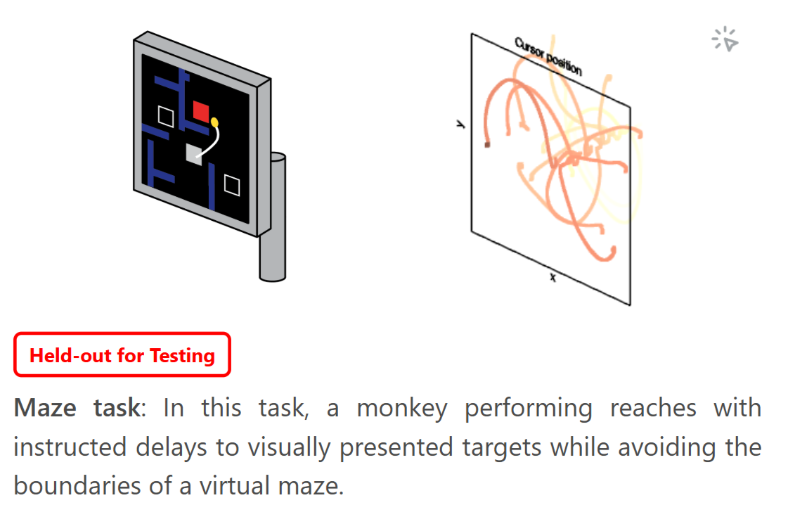
Results on single session data
POYO beats other models when its trained on same amount of data

Slide 15
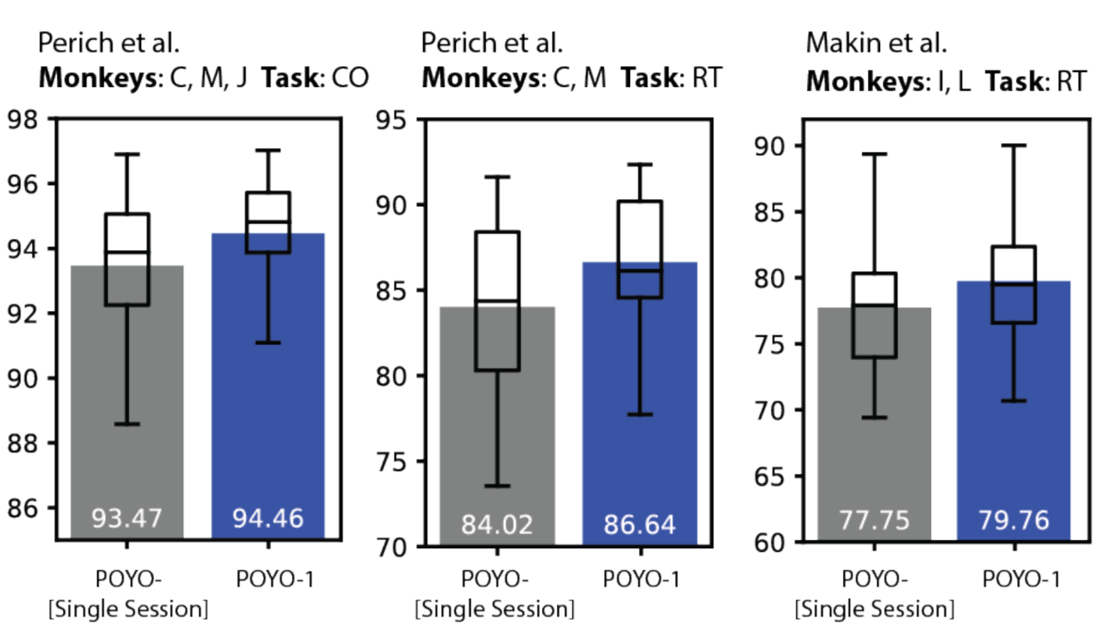
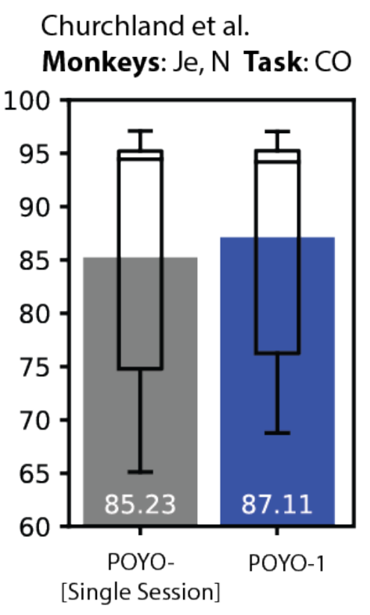
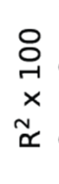
Results on multi-sessions data

Slide 16
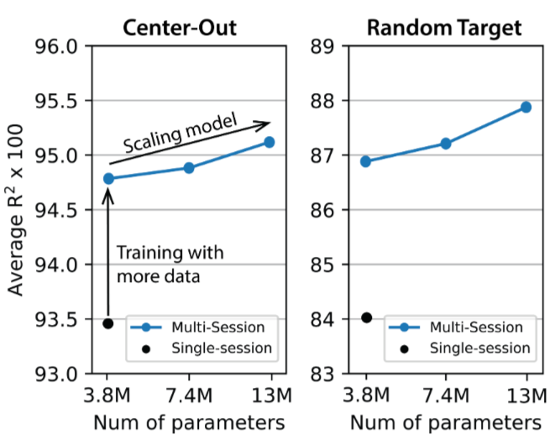
Scaling analysis

Slide 17
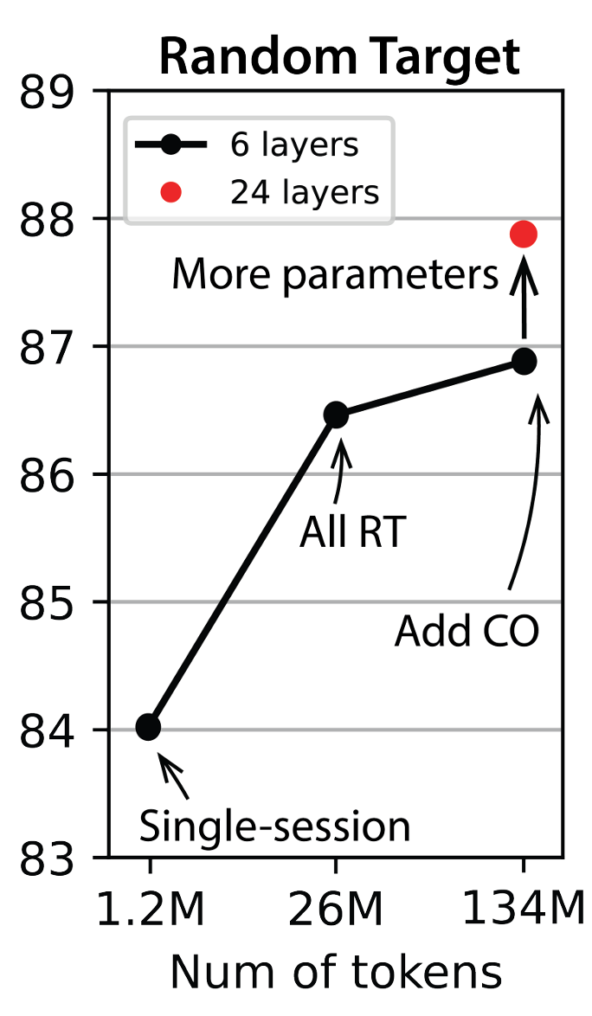
Mixing tasks

Slide 18
Thanks!
Any Questions?
Slides 3-4 adapted from:
Mineault, Patrick. (2025). Foundational models for neuroscience. MAIN Conference, Montreal

